Slide 1
Classification On Colab
Using MNIST Dataset
Name : Maryam Zubair
Student Id : 19709

Slide 2
Classification
Introduction
Design
Implementation
Testing
Enhancement
Conclusion
Bibliography/References

Slide 3
Introduction:
In this problem, I am using MNIST dataset which is a very known example of an image dataset commonly used in machine learning for classification related tasks. The goal of this program is loading and exploring the MNIST dataset to get a sense of what they look like and it works.

Slide 4
Design:
The program is designed to fetch the MNIST dataset from the OpenML repository and extract the image and target data. It then displays an example digit from the dataset and creates two functions plot_digit and plot_digits to display single and multiple images from the dataset, respectively.

Slide 5
Implementation :
In this program, I am using scikit-learn's fetch_openml function to get dataset of handwritten digits. I am taking the dataset and storing information in mnist object which has dictionary like structure. Then extracted the Feature Data and Target Data from the mnist object using the keys "data" and "target". The code is converting a 1D array representing a digit from the MNIST dataset into a 2D array with dimensions 28x28 (784 values). Moreover, I am using two functions to plot grayscale images of digits using Matplotlib which are arranging multiple digit images into a grid and saving the resulting plots to a file.

Slide 6
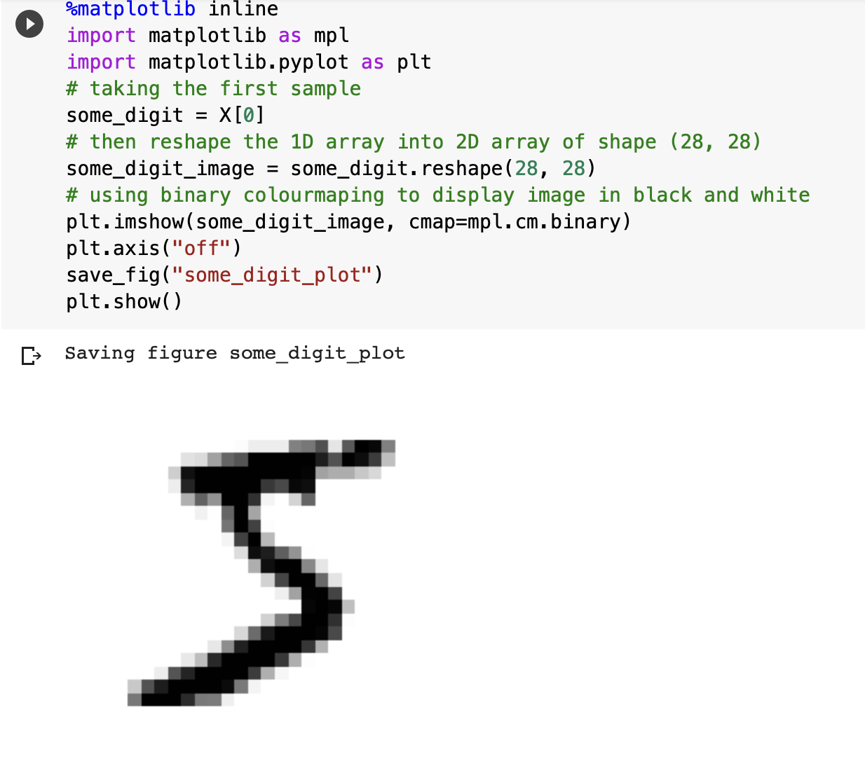
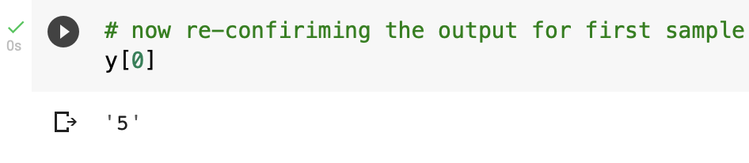
Testing:
The code includes a simple way to check that the images and labels are being loaded correctly. Firstly, I took very first instance in the dataset using X[0] and then reshaped it into 28*28 matrix. The resulting matrix is then displayed as an image using the imshow function in my program. Later, I checked the target value for the same instance to cross verify the results.

Slide 7
Enhancement Ideas
In future we can improve the program by considering following factors:
For now, I just have inspected the data.In future, I can pick some Machine Learning model on MNIST dataset to train the model and evaluate the performance on the testing data.
Moreover, we can try different machine learning models and then compare the performances of the models using various metrics such as accuracy, precision, and recall.

Slide 8
Conclusion:
So this programs just visualizes some example images from the dataset using matplotlib and comparing it with the target values.

